Slide 1
ENGR 1050 Introduction to Engineering (Communication Intensive)
‹#›

Slide 2
Learning Objectives
Define what it is to be an engineer
Demonstrate an understanding of all the engineering degrees offered at LSU.

Slide 3

Ice Breaker
Image from http://lin.ca/alf-griggs-icebreakers
Notes:
Toilet paper ice breaker.
Have students take as much toilet paper as they think they will need. They have to share one fact about themselves for each square of toilet paper they get.
Marooned
Establish a collaborative, cooperative learning environment on the first day of school with Marooned. Place students into groups of five and tell them that they are stranded on a deserted island. Explain that they must select five items from their personal belongings to help them survive and that each member of their group must contribute one thing. Give them about ten minutes to dig through their book bags, purses, or pockets to select necessary items. Then, have each group stand and explain what they selected and how each object is essential to their survival.
Write a letter to your future self
Discuss your classroom strengths and weaknesses and what you hope to gain
from this class.

Slide 4
Pre-test and Prior Knowledge/Attitude Survey
Notes:
Hand out Pre-Test and Engineering Attitude Survey - found in folder
This should take about 20 minutes total. They are not intended to know anything on the pre-test but they should give it a fair effort.
They should take their time on the prior knowledge attitude survey.
They will have to take these again at the end of the course.

Slide 5
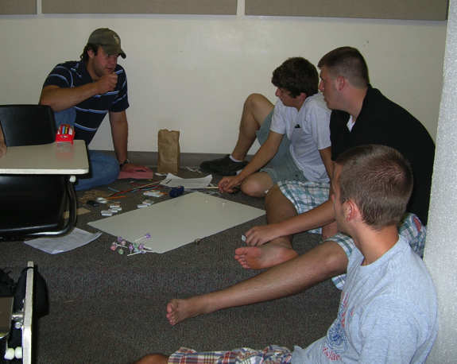
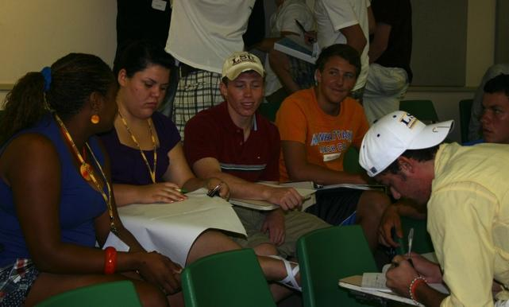
Overview
Background
CI Certified
Class Structure
Syllabus
What do Engineers do?
‹#›
*
Notes:
Background - Teacher’s background with the class
Communication Intensive (CI)/Class Structure/Syllabus on the following slides

Slide 6

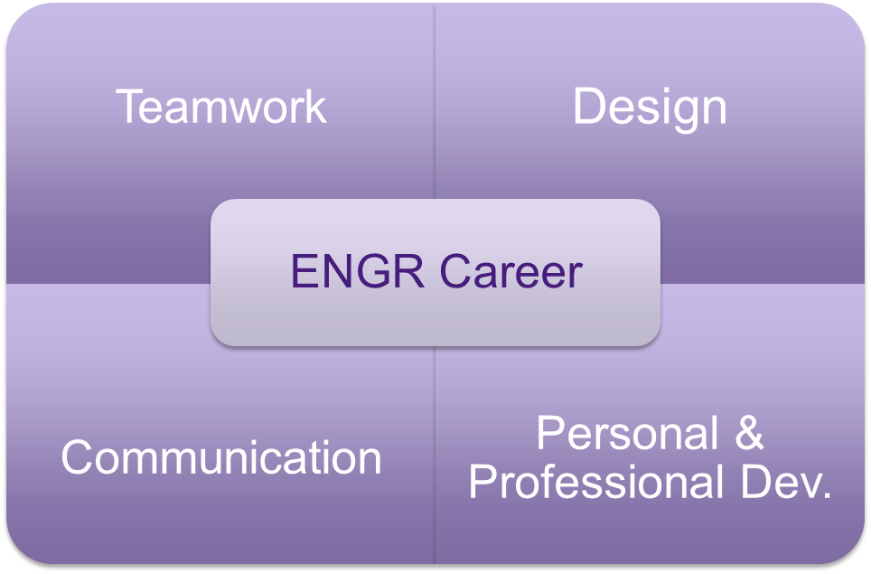
Themes of Class - Syllabus
"A scientist describes what is, and an engineer creates what never was. " Theodore von Karman
*
‹#›
Notes:
Handout Syllabus - found in folder
go over the syllabus especially the grading component. It seems like a lot but after a few weeks, it should get easier to understand the expectations.

Slide 7
Class Structure
Three weeks of introduction
Ethics, Work Ethic, Communication, Teamwork, Design Process
Roughly 1 week for each of the major engineering disciplines
Guest Speaker
Hands on Project with lab report
Presentation of results and quiz
*
‹#›

Slide 8
Guest Speaker Etiquette
Actively Listen
Show Interest
Be free of distractions
Applaud where appropriate
Thank the guest speaker
You are a reflection of your school, of your teacher, and of yourself. Act respectful and be attentive.
Notes:
Actively listen– Do not put your head down on your desk, on your arms, or on your backpack. Do not fall asleep. Your conversation at a mixer, seminar, fundraiser, reception is an important social tool and one in which is necessary for a pleasant and successful event. However, the minute someone picks up a microphone (or heaven forbid – strikes a glass multiple times) to make an announcement, you should graciously discontinue speaking. It’s as easy as saying “Oh, hold that thought, let’s listen to the speaker.” Active listening requires focus on, and eye contact with, the speaker.
Show interest – Nodding in approval (or disapproval depending on the subject matter), applauding at certain key points, and even “oooohing and aaaaahing” over certain remarks, demonstrations, or exhibits is all a way of showing the speaker that you are engaged with his/her content. Depending on the energy or style of the event, it’s perfectly fine to interject a humorous comment…if the speaker seems to be welcoming a more interactive speech. That is not to say one should “heckle” and continually interrupt the speaker; but the occasional comment, question, or laughable moment in a casual environment, is usually well-received by the speaker, particularly if it motivates the crowd or encourages them to listen.
Be free of distractions - Do not play on your phone, tablet, or computer. Do not play with anything in your backpack or at your tables.
Remember to applaud – as soon as the speaker has closed their speech, either by announcing so, or by answering the last question asked. Don’t let the “uncomfortable silence” take place in that first few seconds. Take the lead and start the applause to encourage others who may be unsure if or when they should applaud.
Thank the speaker – Take a few minutes to go up to the emcee or speaker/s and thank them for their contribution to the event. Even if it’s basic announcements, a simple “I enjoyed listening to you, thank you for the nice introductions of key members.”, or “Thank you for sharing your thoughts on the community today. I was very moved by your comment on…..”

Slide 9
Any Questions??
Notes:
Give the students the opportunity to ask any questions about the structure of the class, how grading will be done, or anything else on the syllabus.

Slide 10
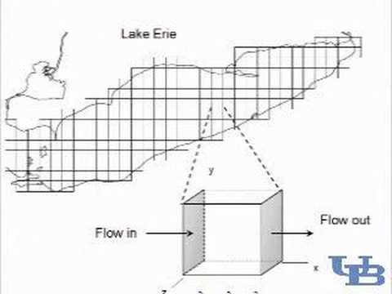
Is Engineering Right For Me?
Notes:
7 minute long video

Slide 11
What is engineering?
Engineering is the discipline, art, skill and profession of acquiring and applying scientific, mathematical, economic, social, and practical knowledge, in order to design and build structures, machines, devices, systems, materials and processes that safely realize improvements to the lives of people.
http://en.wikipedia.org/wiki/Engineering
"Science is about what is; engineering is about what can be” - Neil Armstrong
*
‹#›
Notes:
Give the students 5 minutes to jot down what they think engineering is. (Ideas: HOT (Higher Order Thinking, Poll Everywhere, etc.)
Then share with them the information on the slide.

Slide 12

ABET Definition
Engineering is the profession in which a knowledge of the mathematical and natural sciences gained by study, experience, and practice is applied with judgment to develop ways to utilize, economically, the materials and forces of nature for the benefit of mankind
Picture from endgaim.info
*
‹#›
Notes:
ABET - Accreditation Board for Engineering and Technology, Inc. an accreditation program
ABET audits engineering programs on a regular basis to assure that the program maintains high standards. The recognized accreditor for college and university programs in applied science, computing, engineering, and technology.
Having an engineering degree from a four-year accredited engineering program is required to become a registered professional engineer
Currently accredits around 2,800 programs at more than 600 colleges and universities

Slide 13
What do Engineers do?
Invent – Develop a new product, system, or process that has never existed before
Innovate – Improve an existing technological product, system, or method
Design
Build
Invent
Create
Analyze
Orchestrate
Evaluate
Conceive
Improve
*
Adapted from PLTW
‹#›
Notes:
Students spend 5 minutes discussing with their classmates about what they think Engineers do. (Examples: word cloud, sticky notes, poll everywhere, etc.)
Students share findings.
Then share the information from the slide.
Ask them the difference in inventing and innovating.

Slide 14
Many Disciplines
An electrical engineer may design a GPS for your vehicle.
A chemical engineer may find a cure for disease.
A computer scientist may write a computer program
A mechanical engineer may create a robot to discover water on a planet.
An agricultural engineer may evaluate the effects of global warming on food production.
Etc…..
Engineers make our lives better
*
Adapted from PLTW
‹#›
Notes:
There is a crossword puzzle in the folder. You can hand it out here if you have extra time.

Slide 15
The U.S. government keeps statistics on 17 engineering disciplines
Aerospace
Health and Safety
Agricultural
Industrial
Biomedical
Marine and Ocean
Chemical
Materials
Civil
Mechanical
Computer Hardware
Mining and Geological
Electrical
Nuclear
Electronics
Petroleum
Environmental

Slide 16
Engineering Disciplines at LSU
Biological Eng.
Civil Eng.
Chemical Eng.
Computer/Electrical Eng.
Computer Science
Construction Management
Environmental Eng.
Industrial
Mechanical Eng.
Petroleum Eng.
Notes:
For non DE: You can also share other schools disciplines.
Explain to the students that they will get to do a hands on project for each of these disciplines so they will get to learn a bit more about them.

Slide 17
Career paths for engineers
There are at least seven paths after you graduate:
Corporate ladder
Independent entrepreneur
Military/government
Engineering and social service abroad
Academia/Professor
Graduate/Research
A mix of above

Slide 18
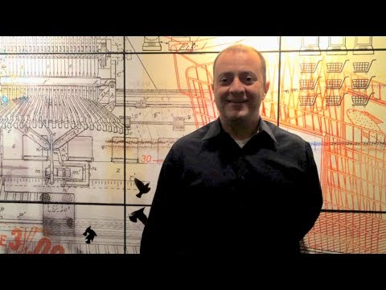
Keys to a Successful Engineering Career
Notes:
2 minutes long video:
Be a Good listener
Be knowledgeable
Get Experience (internship, hands on experience)
Have a broad knowledge base
Get the engineering degree
Alternative video: https://www.youtube.com/watch?v=tSsVRHn5j70 (7 minutes long)

Slide 19

Steps to become a professional engineer
There are 5 key steps:
Earn a degree from an ABET-accredited engineering program
Pass the FE exam
Gain acceptable work experience (typically 4 years under supervision of a PE)
Pass the PE exam in the appropriate discipline
Apply for licensure
Notes:
FE: fundamentals of engineering

Slide 20
What is Science? What is Technology? What is Engineering? What is Mathematics? What is STEM?
Notes:
You’ve all probably heard of STEM by this point but what is stem and how do engineers fit in?

Slide 21
How do Engineers fit in?
Scientists
Investigate our
natural world
Technologists
Apply science and
math to designs
STEM
Working together
to solve problems
based on societal
needs and wants
Mathematicians
Use numbers and symbols
to solve problems
Engineers
Create our
designed world
*
Adapted from PLTW
‹#›

Slide 22

Problems That Solve Our Needs and Wants
What are our human needs?
PHYSICAL NEEDS:
Basic shelter
Basic clothing
Can you think of more?
BIOLOGICAL NEEDS:
Water
Food
Can you think of more?
PSYCHOLOGICAL NEEDS:
Family
Friends
Can you think of more?
Notes:
You can have a discussion with the class about needs vs. wants. Can you think of products that engineers have designed that address our human needs?

Slide 23

Problems That Solve Our
Needs and Wants
What are our human wants?
PHYSICAL WANTS:
Nice house
Nice car
Nice clothes
Can you think of more?
BIOLOGICAL WANTS:
Fresh water
Fancy food
Healthy living
Can you think of more?
PSYCHOLOGICAL WANTS:
Talk with family
See friends
Entertainment
Can you think of more?
Notes:
Can you think of products that engineers have designed that address our human wants?

Slide 24


Discussion Questions
What product or system would make your life better?
Is this solving a want or a need?
What type(s) of engineer(s) might work on this project?
*
Adapted from PLTW
‹#›
Notes:
Mini exercise. Have them work in pairs to answer these questions. This is not a graded assignment but they should give it a good attempt. If they are less than thrilled to do this, you can remind them that each week they get a 10 point work ethic grade that is based on their participation and work ethic each day.
An alternative/additional exercise would be to assign each group one (for pairs) or two (for groups of 3 to 4) engineering disciplines and have them spend 10-15 minutes researching their specific engineering discipline and have them present it to the class.
Image source:Microsoft, Inc. (2008). Clip Art. Retrieved September 10, 2008, from http://office.microsoft.com/en-us/clipart/default.aspx

